Slide 1
UNIT-1(Lesson 9)
Arithmetic Operators, Comparison Operators

Slide 2
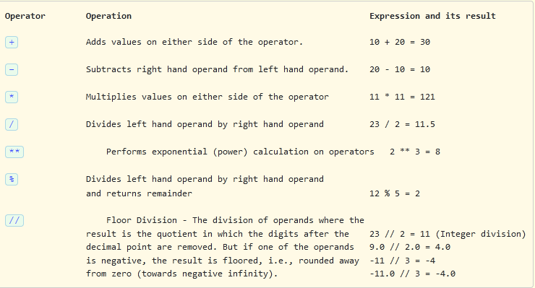
Arithmetic Operators
Python supports the following 7 arithmetic operators.

Slide 3
Write a program to read two int inputs from the user and perform the following arithmetic operations addition, subtraction, multiplication, and division and print the result.
During execution, the program should print the message on the console as:
Enter num1:
Enter num2:
For example, if the user gives the input as:
Enter num1: 40
Enter num2: 10
Sample Input and Output:
Addition of 40 and 10 = 50
Subtraction of 40 and 10 = 30
Multiplication of 40 and 10 = 400
Division of 40 and 10 = 4.0

Slide 4
Which one of these is floor division?
a) / b) // c) % d) None of the mentioned

Slide 5
Which one of these is floor division?
a) / b) // c) % d) None of the mentioned

Slide 6
What will be the output of following code
x=125
y=13
x//=y
print(x)
a.125/13
b.10
c.9
d.9.62

Slide 7
What will be the output of following code
x=125
y=13
x//=y
print(x)
a.125/13
b.10
c.9
d.9.62

Slide 8
What is the answer to this expression, 22 % 3 is?
a) 7 b) 1 c) 0 d) 5

Slide 9
What is the answer to this expression, 22 % 3 is?
a) 7 b) 1 c) 0 d) 5

Slide 10
The divmod(dividend,divisor)
The divmod(dividend,divisor) function returns a tuple containing the quotient and the remainder, when argument1 (dividend) is divided by argument2 (divisor). The syntax of the divmod() function is :
divmod(x, y)
x - a non-complex number (numerator)
y - a non-complex number (denominator)
The divmod() returns (q, r) - a pair of numbers (a tuple) consisting of quotient q and remainder r
Note: If x and y are integers, the return value from divmod() is same as (x // y, x % y).
Note: If either x or y is a float, the result is (q, x%y). Here, q is the whole part of the quotient.
Understand the working of divmod() by the following examples :
Statement Result
print(divmod(8, 3)) (2, 2)
print(divmod(3, 8)) (0,3)

Slide 11
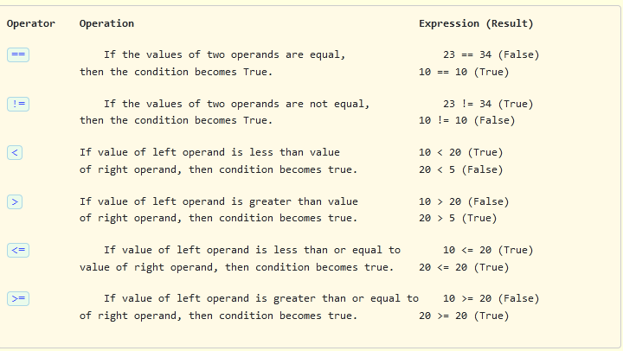
Comparison Operators
Python supports the following comparison operators. The result of these comparison operators is either True or False.

Slide 12
Write a program to understand the comparison operators in Python and perform the following operations >, <, ==, !=, <=, >= and print the result. Take two int inputs from the user.
For example, if the user gives the input as:
Enter num1: 40
Enter num2: 10
Sample Input and Output :
Is 40 greater than 10 = True
Is 40 less than 10 = False
Is 40 equal to 10 = False
Is 40 not equal to 10 = True
Is 40 less than or equal to 10 = False
Is 40 greater than or equal to 10 = True

Slide 13
Comparison operators with strings
All the comparison operators work on strings also. The result is either True or False. Python compares strings using Unicode value of the characters (lexicographical). The comparison is made taking the ordinal values of each character in the string and compare it with the ordinal values of the character at the same position in the other string. If the ordinal value of the character in the first string is greater than the ordinal value of the character in the second string, then the comparison stops and the first string is declared greater than the second string. The length of the string does not matter. In Python, the ordinal value of a character can be found using the ord() function, which takes the character as an argument.

Slide 14
Identify correct comparison operators
a)>>=
b)==
c)!=
d)Both b and c

Slide 15
Identify correct comparison operators
a)>>=
b)==
c)!=
d)Both b and c

